Slide 1
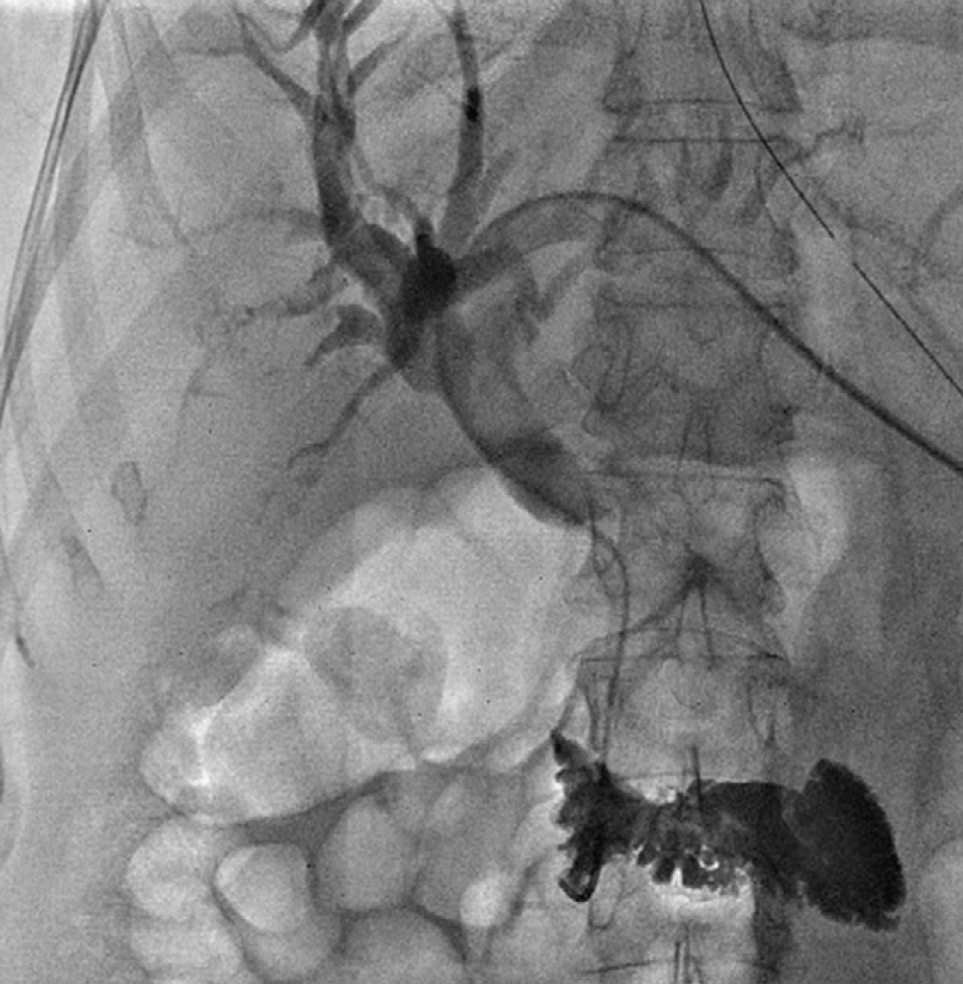


Role of Interventional Radiology in the Management of Biliary Obstruction and Jaundice
.
Hammed Ninalowo MD DABR-IR/DR
Consultant Vascular and Interventional Radiologist
Subspecialty Interventional Oncology.
Founder and CEO, IRDOCNIGERIA.
WEB: irdocnigeria.org

Slide 2
Causes of Biliary obstruction
Malignant 70-80%
Cholangiocarcinoma
Pancreatic Adenocarcinoma
Gall bladder cancer
Hepatocellular cancer
Metastatic disease
Lymphoma
Benign 20-30%
Iatrogenic( 80-90%)
Pancreatitis(8.2-13.9%)
Primary sclerosing cholangitis
IgG 4 Cholangiopathy
Other miscellaneous causes.
Curative resection only possible in less than 20% due to local spread and inoperable disease.
→
Med Mol Morphol 2016;49:189-202

Slide 3
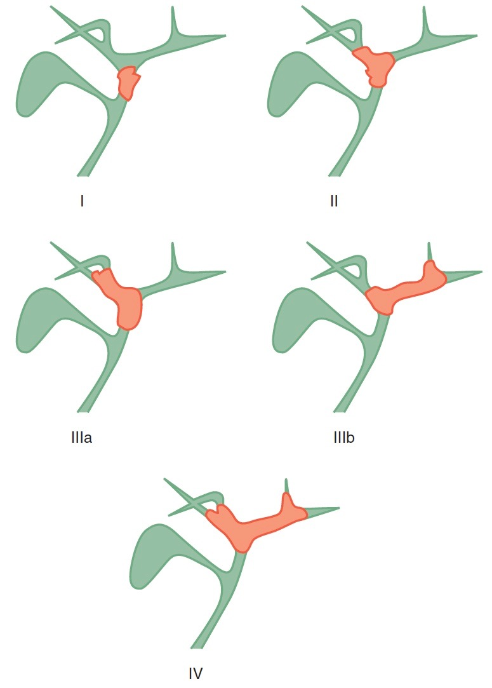
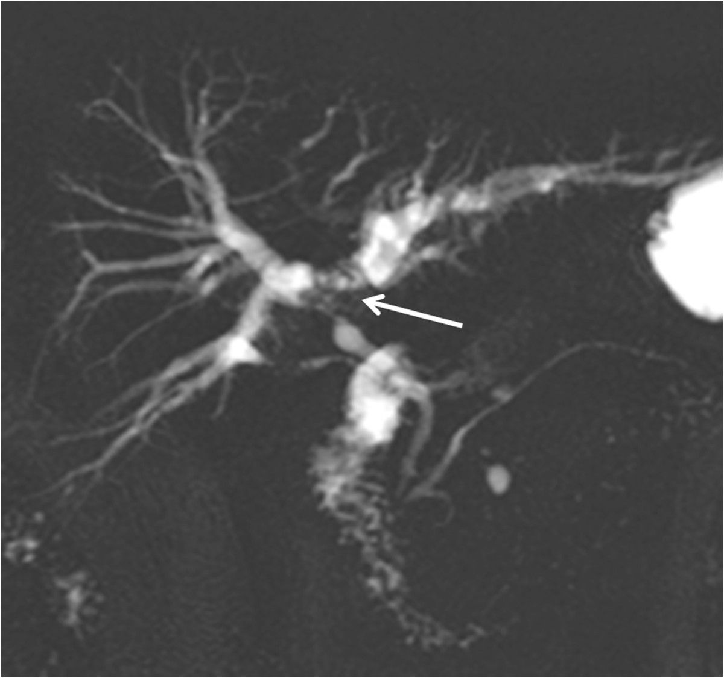
Diagnosis
Bismuth-Corlette classification system for perihilar cholangiocarcinoma.
Notes:
Background in Diagnosis and significant value in Diagnosis
Modern imaging capabilities permit robust noninvasive evaluation of the obstructed biliary tree.
Differentiation of benign and malignant causes of bile duct obstruction is essential because treatments are different.
Type 1L involve the common hepatic duct but do not extend into the confluence. This pattern is functionally equivalent to a low bile
duct obstruction in that it can be treated with a single catheter or stent from either a right- or left-sided approach.
Type 2 obstructions isolate the right and left hepatic ducts from each other. Complete drainage of such obstructions
can be accomplished by placement of a right-to-left (or leftto- right) external biliary drainage catheter, placement of bilateral internal-external biliary drainage catheters, or placement of metallic stents in either a Y or T configuration.
In type 3 obstructions, disease extends into either the left
or right hepatic duct, producing sectoral or segmental isolations.
Complete drainage of either the left (type 3A) or right
(type 3B) hemiliver can be accomplished using a single
catheter or stent; drainage of more liver parenchyma would
require additional drains or stents. Type 4 obstructions
extend into both left and right hepatic ducts and/or into
segmental bile ducts, creating multiple intrahepatic biliary
isolations. For patients with this type of obstruction, the
appropriateness and type of biliary drainage should be carefully
considered on a case-by-case basis in view of the indication,
likelihood of success in achieving the desired clinical
endpoint, and potential attendant complications. Complete
biliary drainage cannot usually be obtained for patients
with such advanced disease.

Slide 4
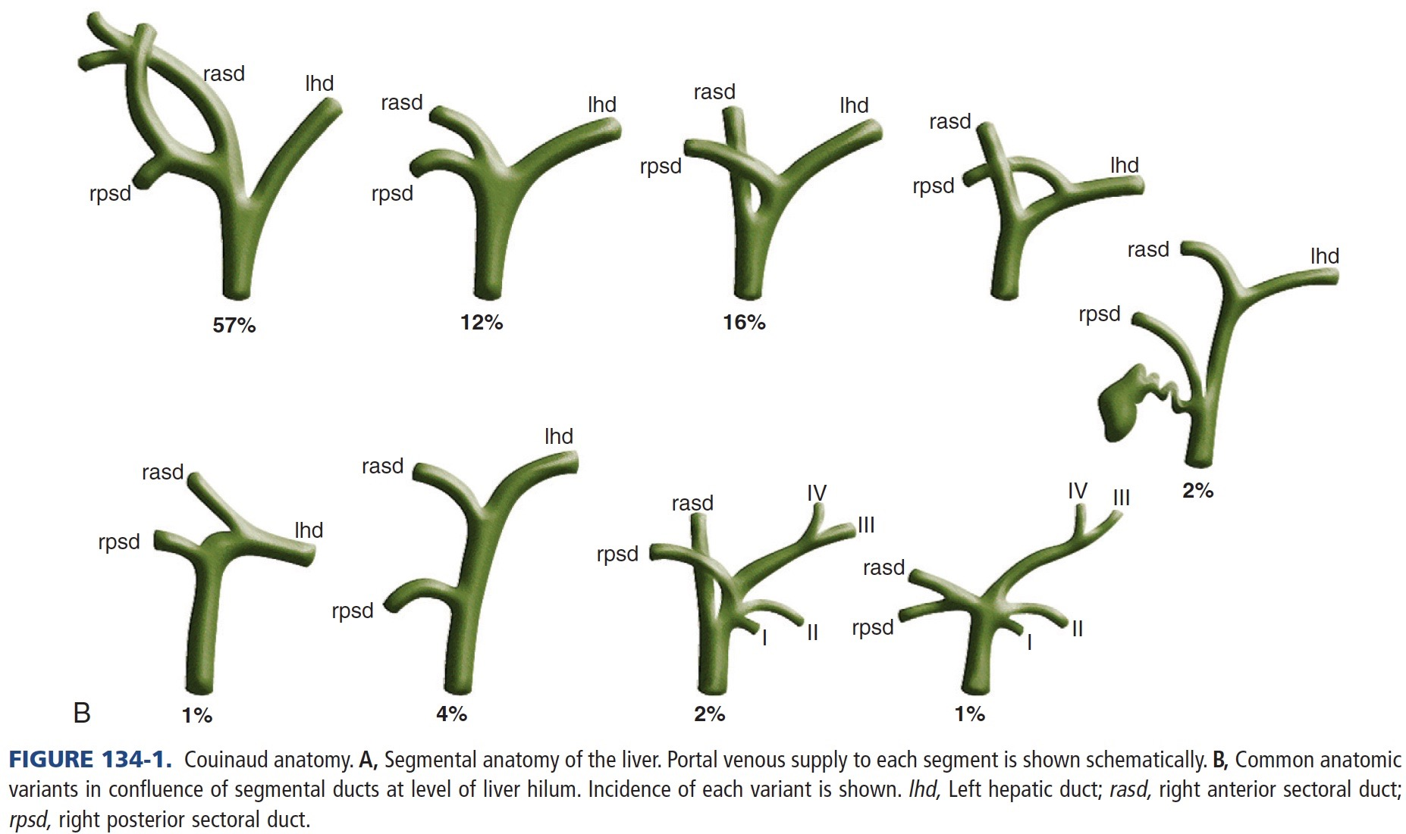
Recognition of Variant Biliary Ductal Anatomy
Notes:
Right anterior: 5 and segment 8
The right posterior: 6 and 7.
BILIARY TRACT
Important common variants of biliary anatomy must be understood. Several of these involve variant insertions of the right-sided sectoral ducts. One common example occurs when the right posterior sectoral duct drains to the left hepatic duct instead of joining the right anterior duct. In certain hilar occlusions where this anatomic variant is present, drainage of the right posterior sector may confer drainage of 6 liver segments (segments 1-4, 6, and 7), whereas drainage of the anterior sector would accomplish drainage of only 2 segments (segments 5 and 8) in such instances.
Evaluation of Preprocedural Imaging Studies In MBDO, preprocedural imaging studies must be carefully studied to predict the procedural cholangiogram. This is important so as to plan a biliary drainage that will provide maximal drainage with as few catheters/stents as possible.

Slide 5
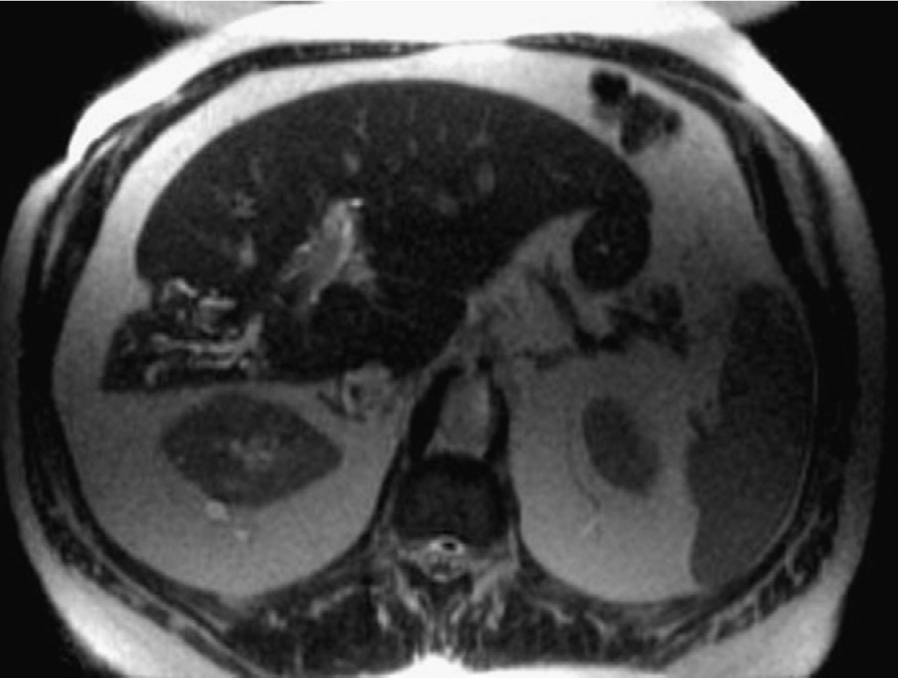
Importance of evaluation of Imaging
Recognition of Variant Biliary Ductal Anatomy
Parenchymal atrophy: Drainage of atrophied segments unlikely to provide benefit in terms of recovery of liver function or decreased bilirubin.
Portal vein status: 80% of blood supply from portal vein. Therefore, if recovery of liver function is the intended goal of drainage, only liver segments with patent portal venous supply should be targeted for drainage.
Ascites

Slide 6
When to think IR
IDEAL SETTING WITH READILY AVAILABLE ERCP AND IR
Low bile duct obstruction (obstruction of the common bile duct or common hepatic duct not involving the biliary confluence or some Billroth Type I and II) → ERCP
High bile duct obstruction (obstruction proximal to or involving the confluence of left and right hepatic ducts( Type III or IV)→IR
CURRENT STATE IN NIGERIA
ERCP not readily available in most centers
Complex Interventional Radiology also not readily
Notes:
→For patients with low bile duct obstruction (obstruction of the common bile duct or common hepatic duct not involving the biliary confluence), endoscopic techniques commonly permit diagnosis and therapy without the need for percutaneous approaches or exteriorized drainage catheters.
→High bile duct obstruction (obstruction proximal to or involving the confluence of left and right hepatic ducts) is more often managed percutaneously by interventional radiologists.

Slide 7

IR tool box in Management of MBDO
Percutaneous transhepatic cholangiogram(PTC)
Bile duct biopsy.
Percutaneous transhepatic biliary drainage (PTBD)
Stent placement.

Slide 8
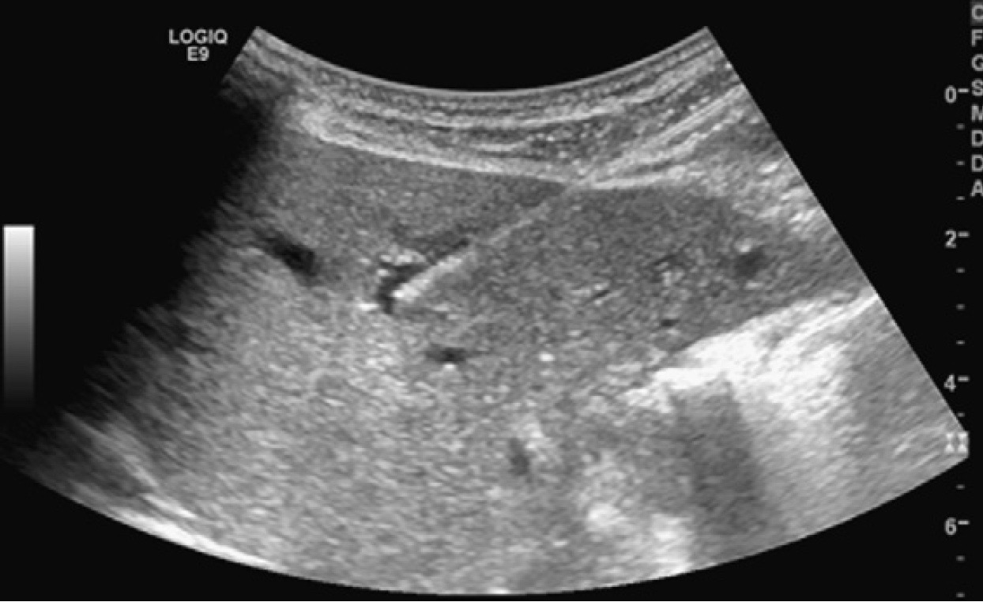
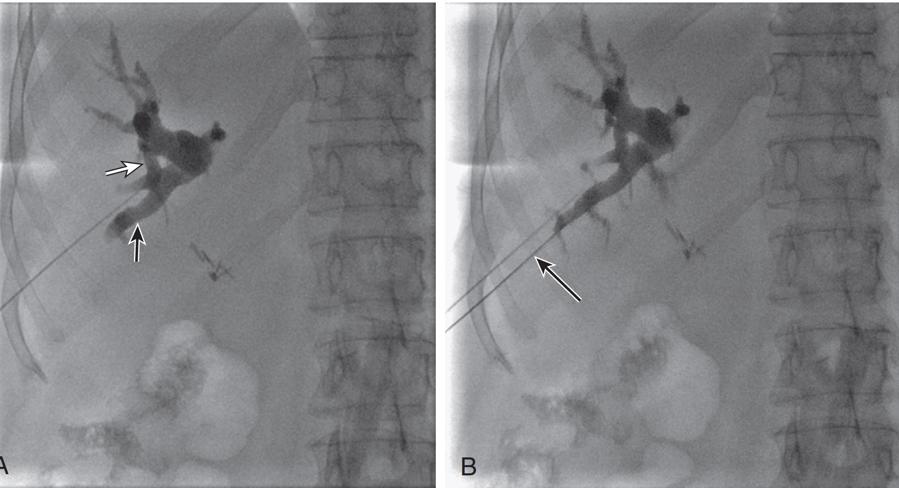
Percutaneous Transhepatic Cholangiogram(PTC)
Flouroscopic or Ultrasound guided needle targeting
Injection of contrast to define Anatomy
Target peripheral duct for Access

Slide 9
Percutaneous Biopsy Techniques
Brush cytology
Transluminal Needle biopsy
Transluminal Forceps biopsy-Flouroscopy guided

Slide 10
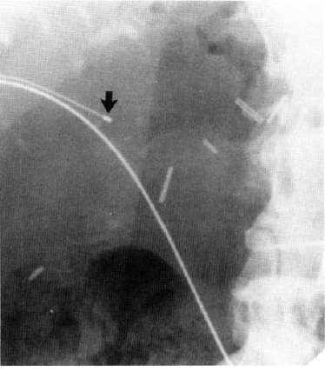
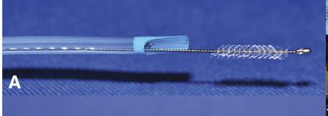
Brush cytology
PTC and cross stricture with wire
7/8 Fr Sheath across stricture
Brush Biospy forceos to level of stricture
Sheath withdrawn to expose brush and to and fro motion
Brush placed in container
Sensitivity 30-60%.

Slide 11
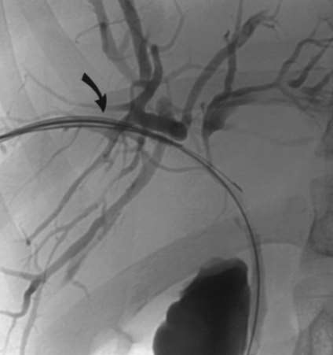
Transluminal needle Biopsy
PTC and cross the stricture with wire
9 F sheath
Trans jugular liver biopsy set 14 G curved metal cannula 60 cm 19 g gun with 2 cm throw
Higher yield for extra-luminal pathology
Sensitivity: 76-80%
JVIR 2001;12:1437-39

Slide 12
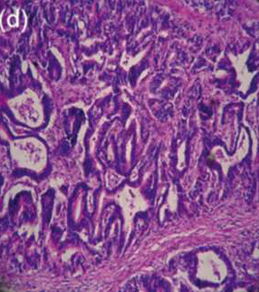
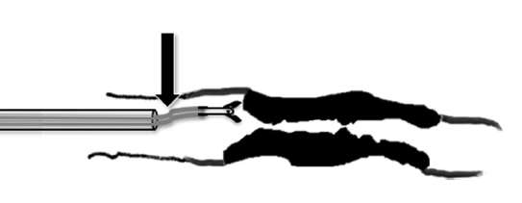
Transluminal Forceps Biopsy (Fluroscopic)
PTC and cross the stricture with amplatzwire
7 Fr sheath with end marker parked within the stricture
5.2F Cook 60 cm myocardial biopsy forceps..2.5 cc cup
Withdraw the sheath with end marker proximal to the stricture
Intraluminal lesion
Sensitivity 78%, lower for ampullary masses
Radiology2002; 224:725–730

Slide 13
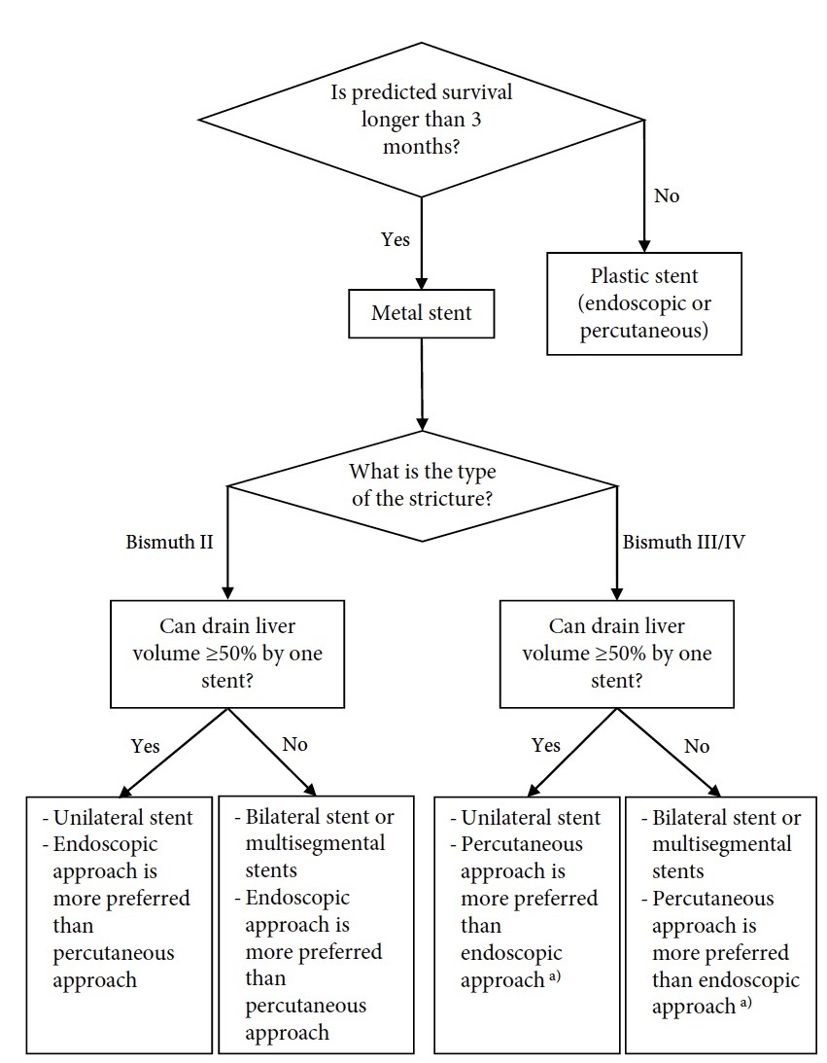
Decision Making Metal or plastic stent

Slide 14
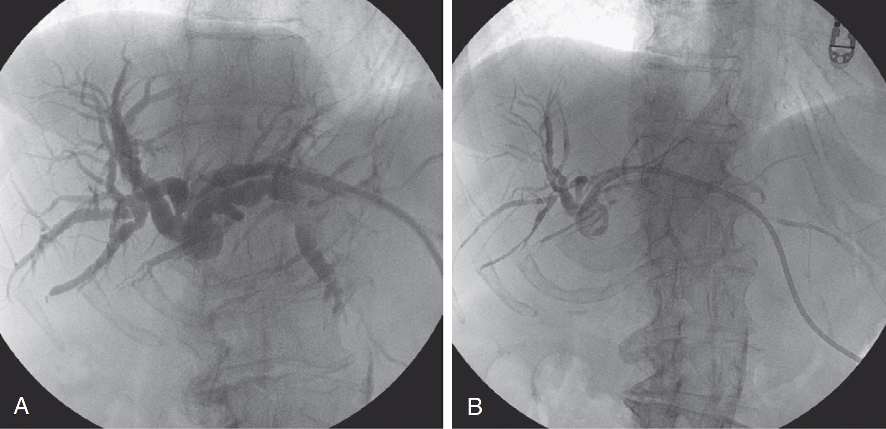
Percutaneous Transhepatic Biliary drainage (PTBD)
External Biliary Drainage
→Bile drains to external bag.
Most drainage currently done in Nigeria External

Slide 15
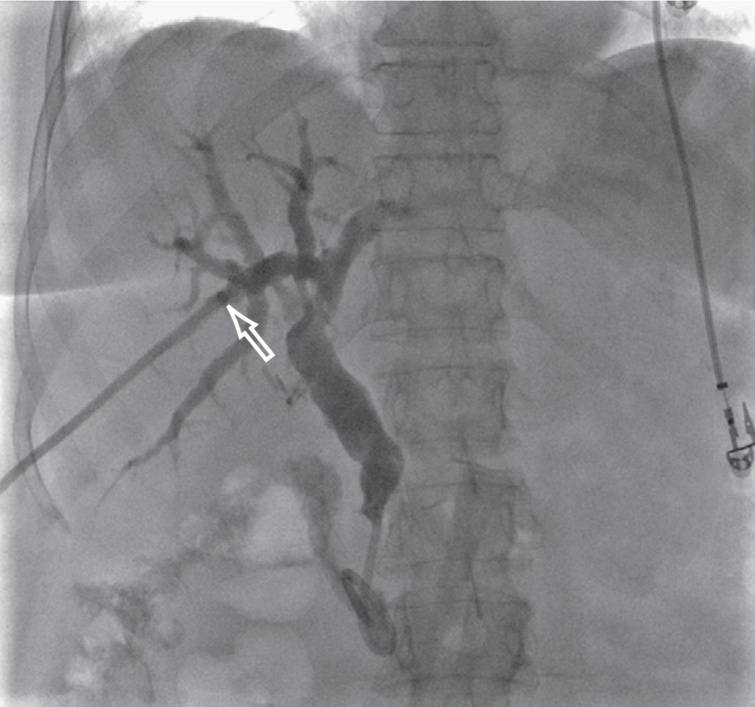
Percutaneous Transhepatic biliary drainage (PTBD)
Internal/External Biliary Drainage
Drainage catheter with locking loop and multiple side holes
Some side holes above obstruction and distal side holes within the duodenum
→Catheter can be capped to force internal drainage
Improved Catheter stability compared to external.
Physiologic conditions with bile salts deposited in intestine.

Slide 16
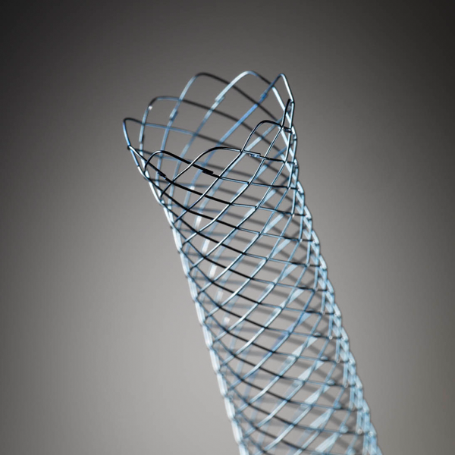
Stenting
Minimizes impact on patient lifestyle when compared to IEBDs and EBDs.
Median stent patency for metallic stents 6-9 months.
Cost?
Goal: Drain at least 50% of liver volume
Greater decrease in bilirubin level
Lower incidence of early cholangitis
Longer survival
Notes:
Stents intended to be positioned across the ampulla of Vater ideally project about 10 mm into the duodenal lumen.
Stents not intended to cross the ampulla of Vater are ideally positioned no closer than 2 cm to it so as not to cause ampullary spasm.
Patiency much longer than plastic stents

Slide 17
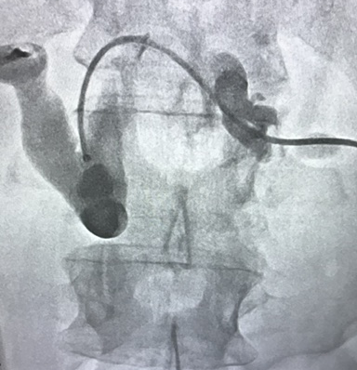
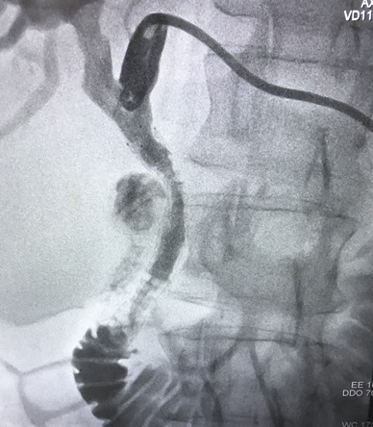
78 y/o male with Type I malignant obstruction and jaundice.
Notes:
When completion cholangiography shows antegrade passage of injected contrast material through the stent into the intestinal outflow, a decision must be made about whether or not percutaneous access to the biliary tree has to be preserved. If the stent is patent and the biliary tree does not contain blood clots that might block it, percutaneous access can be immediately abandoned by placing a Gelfoam pledget through the access sheath at the site of bile duct puncture.
Short-term continued access to the biliary tree may be desired when procedural hemobilia has occurred or when
there are doubts regarding the adequacy of stent function. In such cases, a 4F or 5F angiographic catheter can be
placed over wire into the biliary tree to preserve access. If the stent has been placed across the ampulla of Vater, this
catheter can be placed into the duodenum. If the stent has been placed above the ampulla of Vater, the catheter should
be placed within the stent but not through the ampulla, so as not to cause ampullary spasm. Larger drainage
catheters can be removed in 7 to 10 days following formation of a tract, as a safeguard against peritoneal leakage of
Bile. Delayed

Slide 18
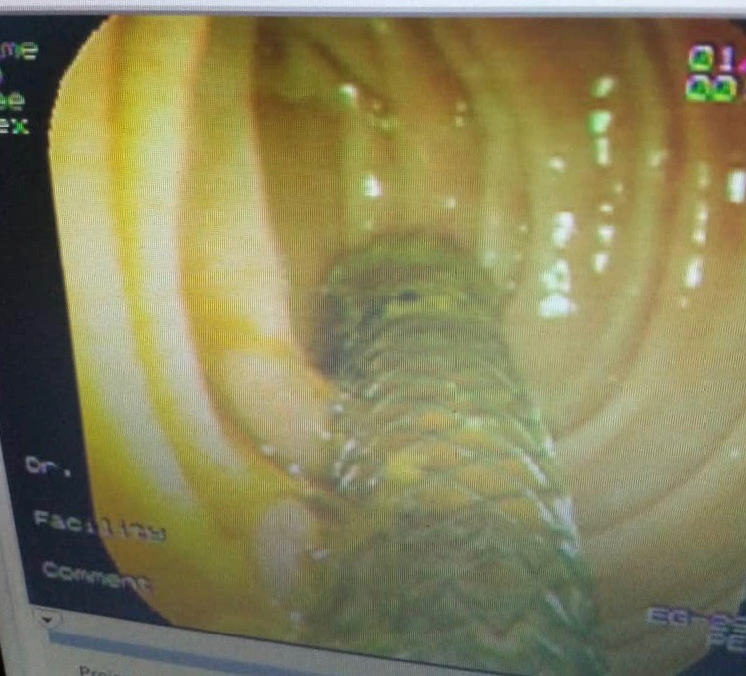
Same patient 6 months later
Stent patient
Resolved Jaundice
Improved Weight and QOL
Images Courtesy of Dr Remi Oluyemi

Slide 19
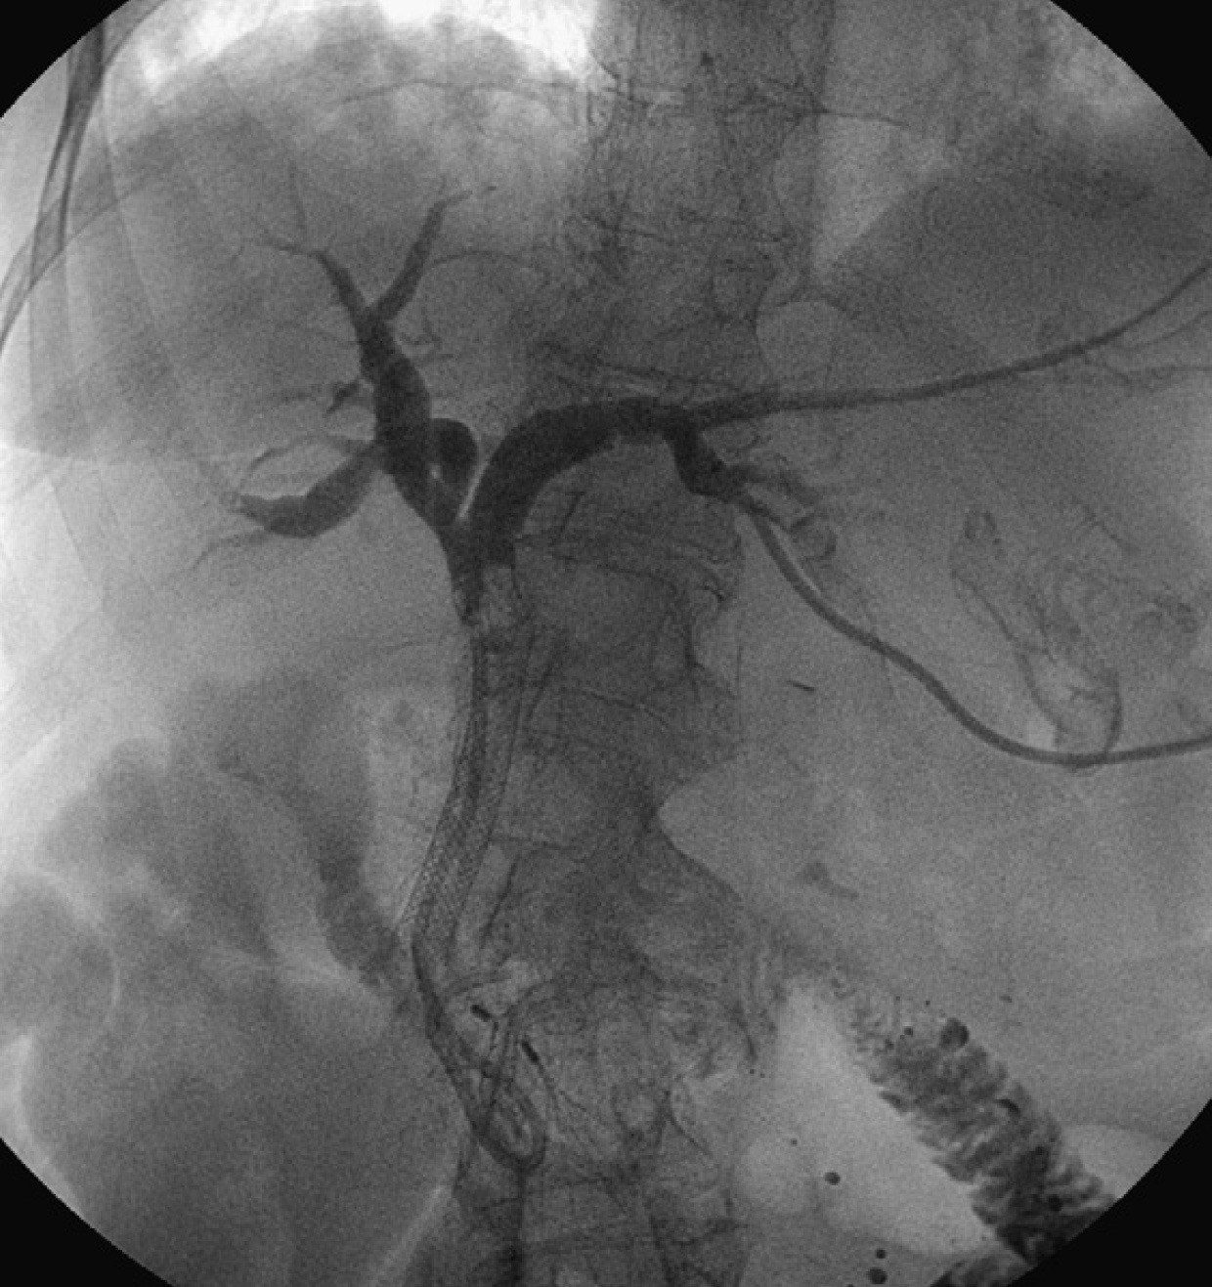
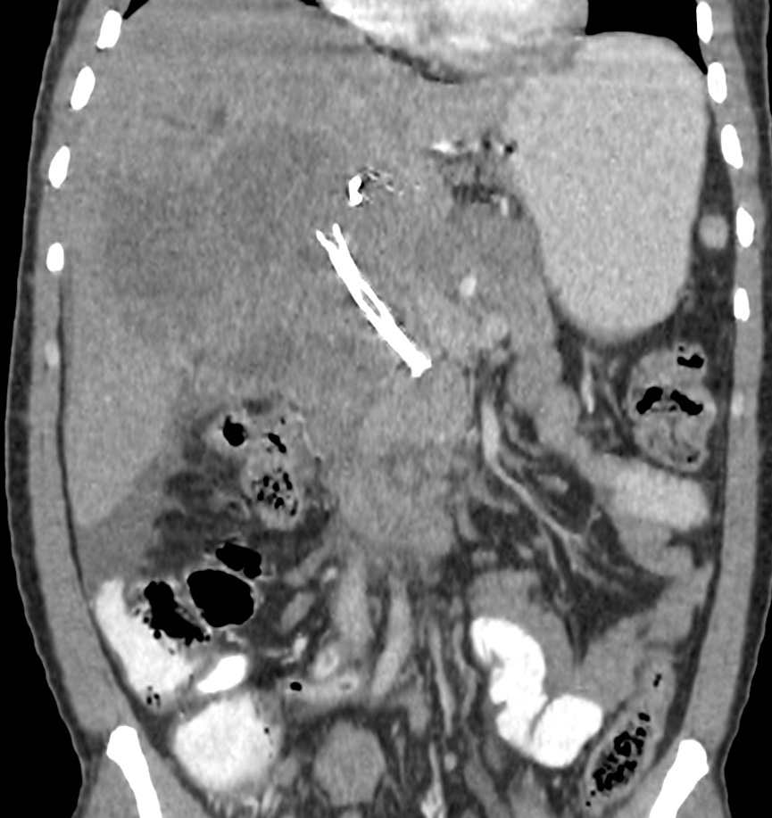
Stent complications
Mechanisms of occlusion of SEMS
Ingrowth: tumor grows between the mesh lines of the stent
Overgrowth:tumor blocks either the proximal or distal end of the stent.

Slide 20
BENIGN BILIARY PATHOLOGY

Slide 21
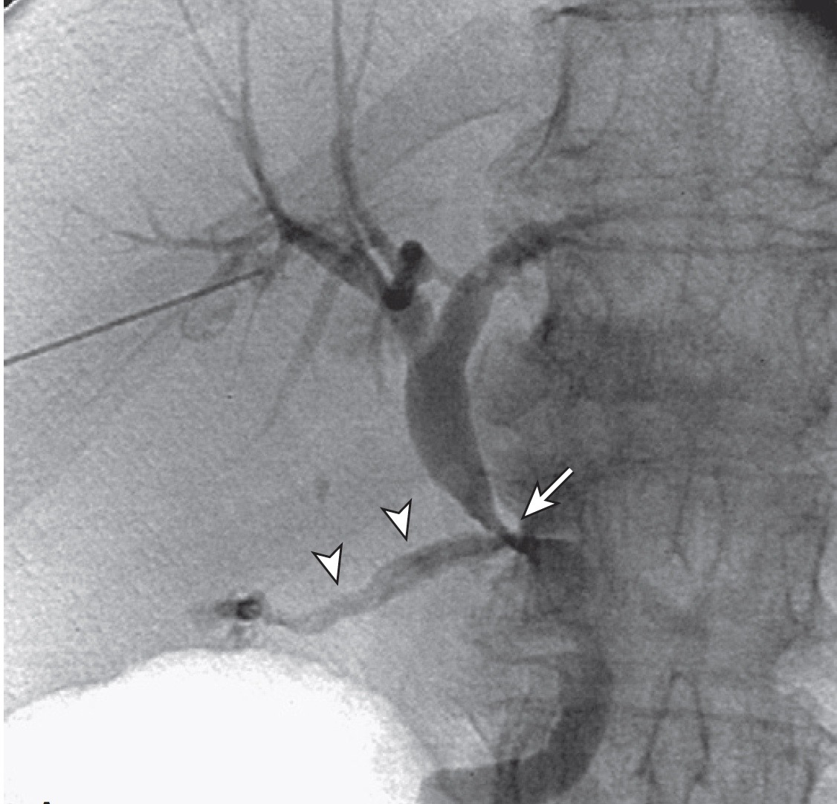
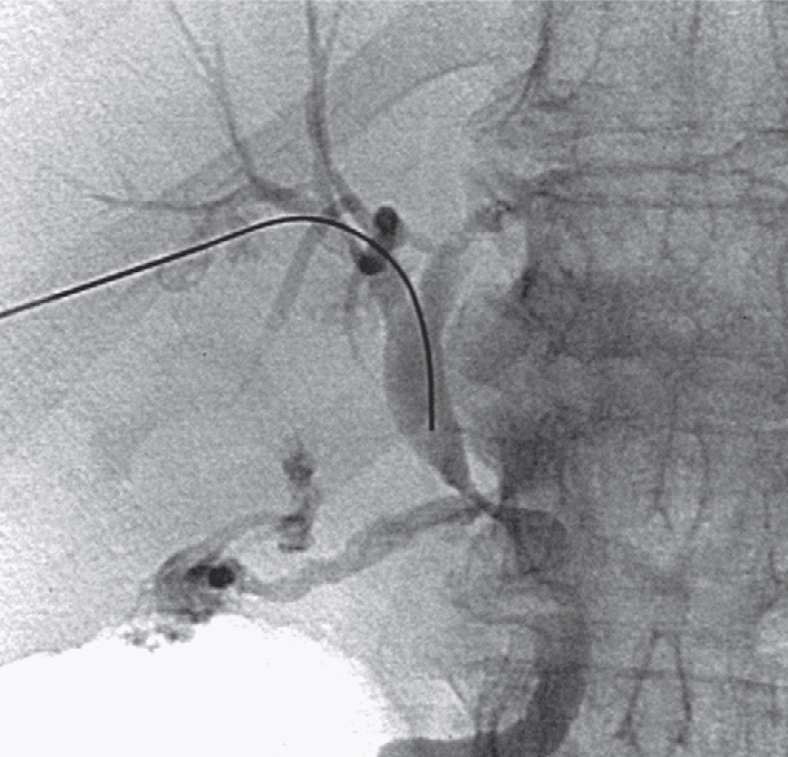
78 y/o female with contained perforation of an inflammed GB underwent open cholecystectomy. Operation complicated by extensive inflammatory tissue.
Management of Biliary Leaks

Slide 22
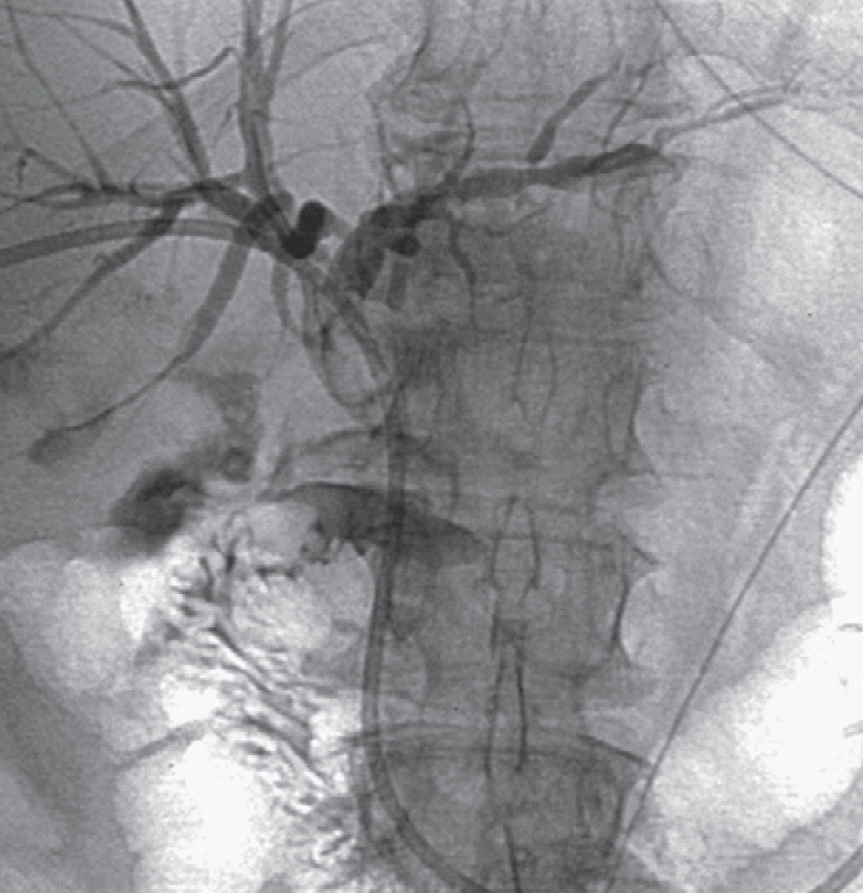
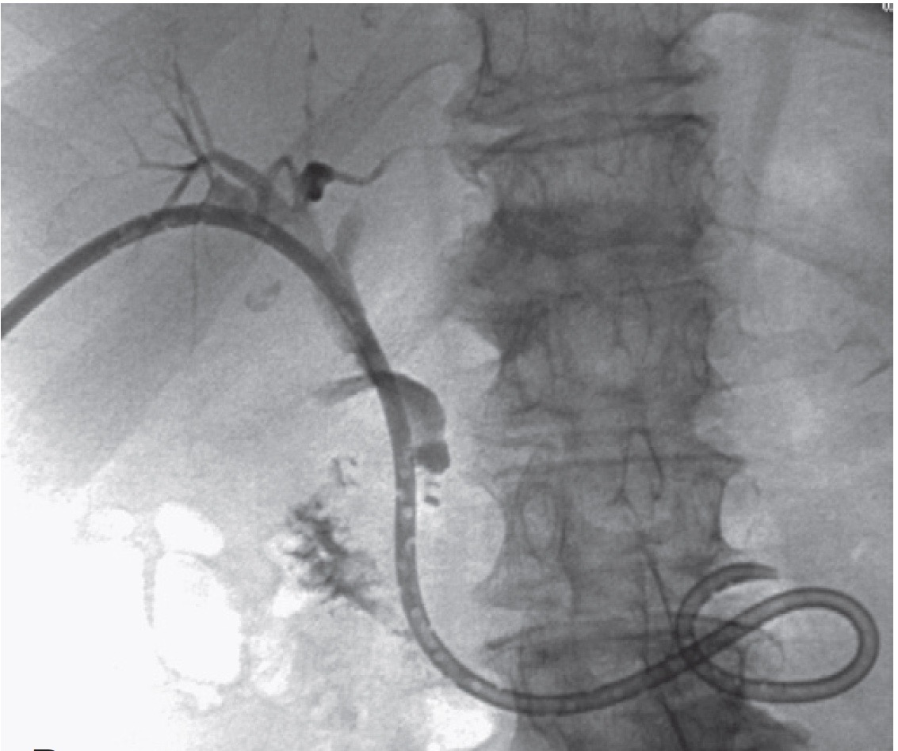
8.5 Fr Internal/External catheter placed. 2 weeks later inflammatory markers decreased. Only cystic duct stump seen.

Slide 23
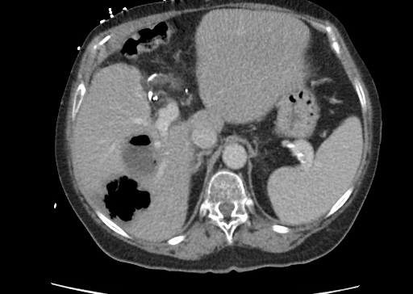
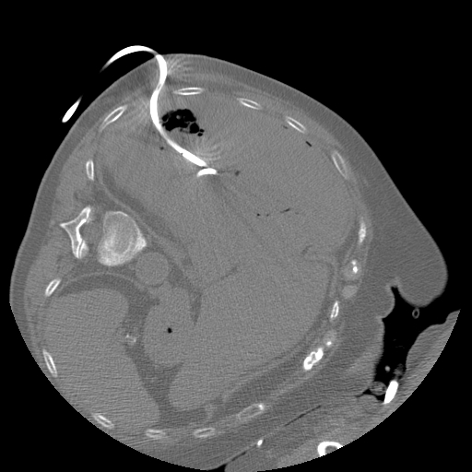
64 y/o male with h/o pancreatic ca s/p whipple who presented with hepatic abscess with note of occluded common hepatic artery

Slide 24
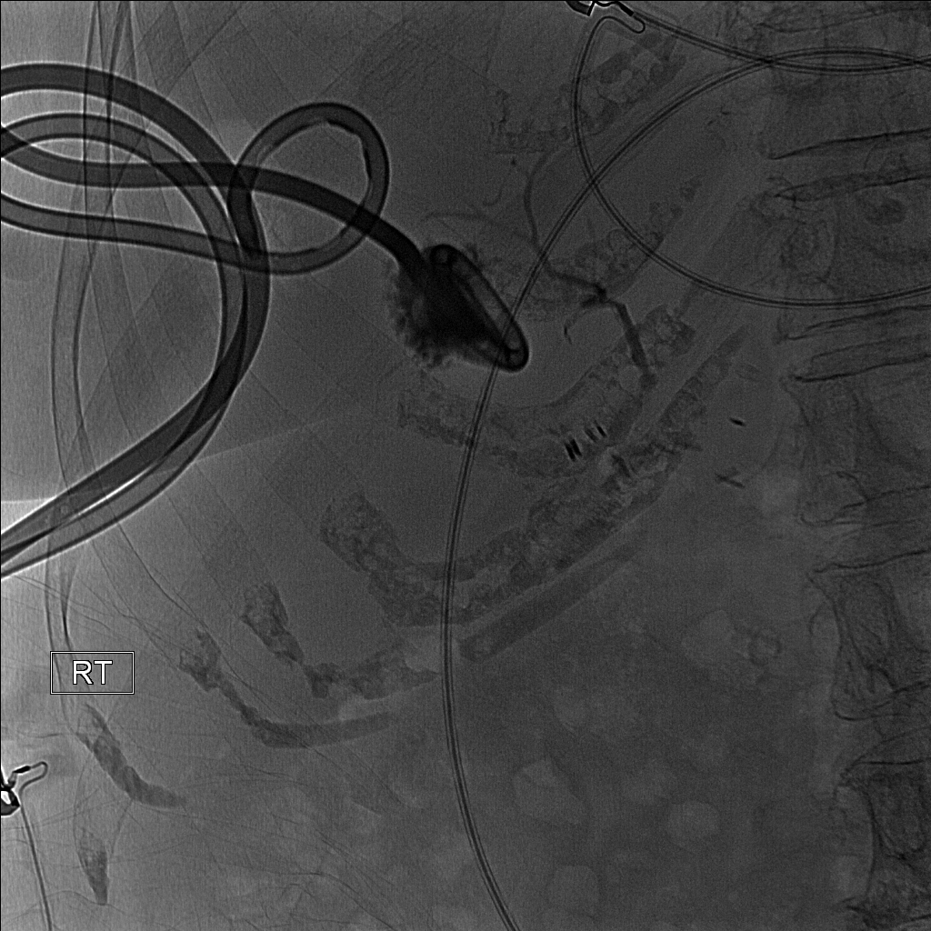
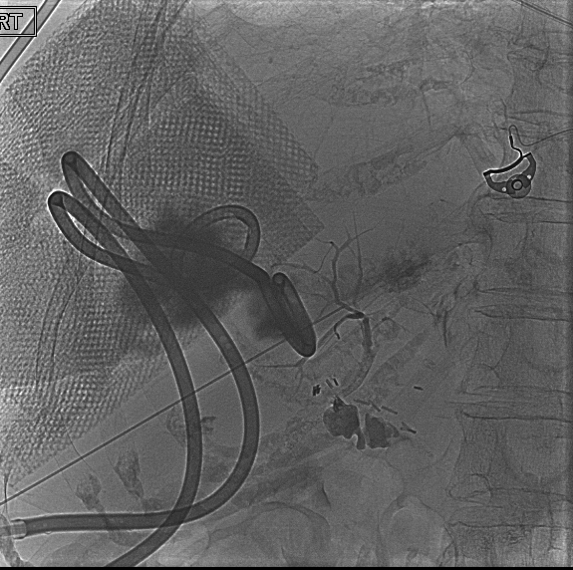
Cholangiogram shows connection to the Biliary tree

Slide 25
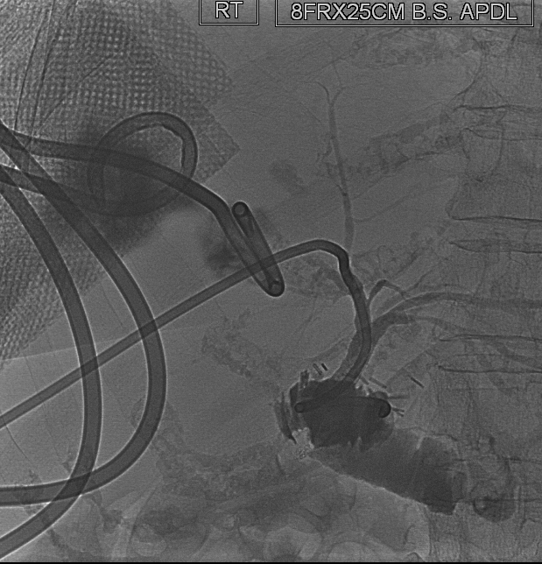
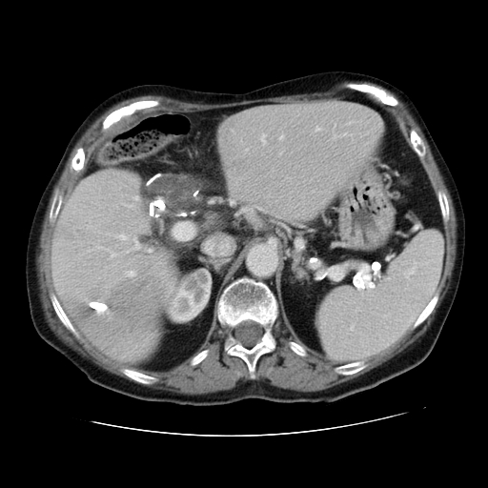
CT shows occluded common Hepatic Artery

Slide 26
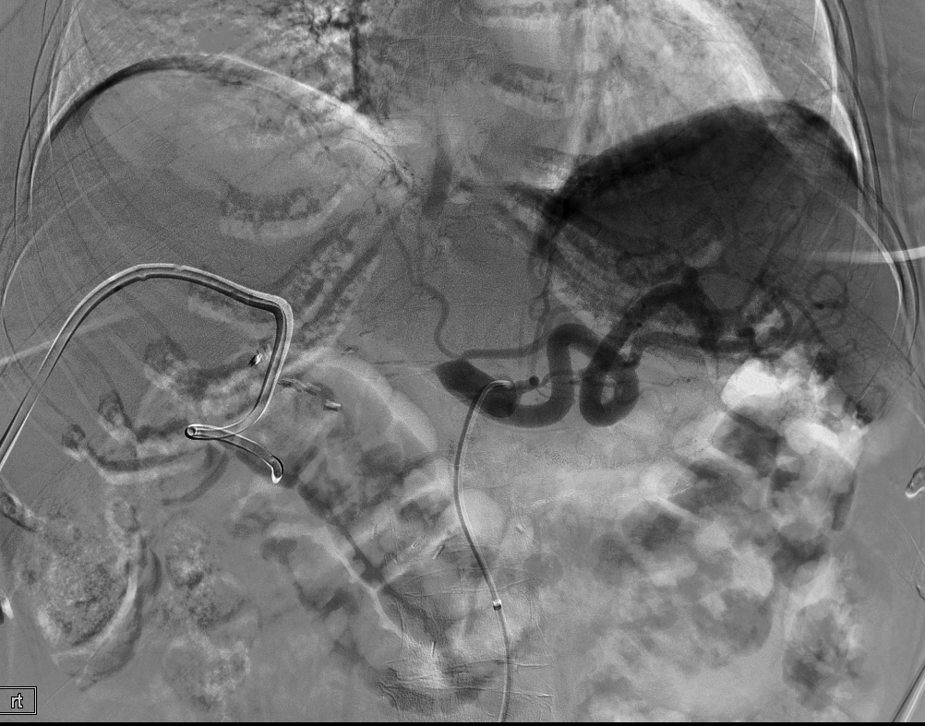
Arteriogram showing occlusion of the common hepatic artery

Slide 27
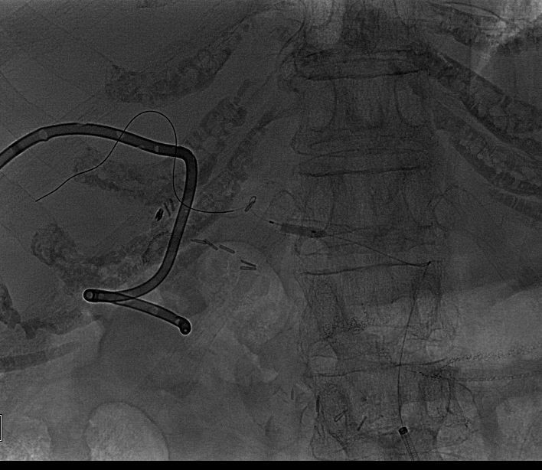
Hepatic artery Angioplasty

Slide 28
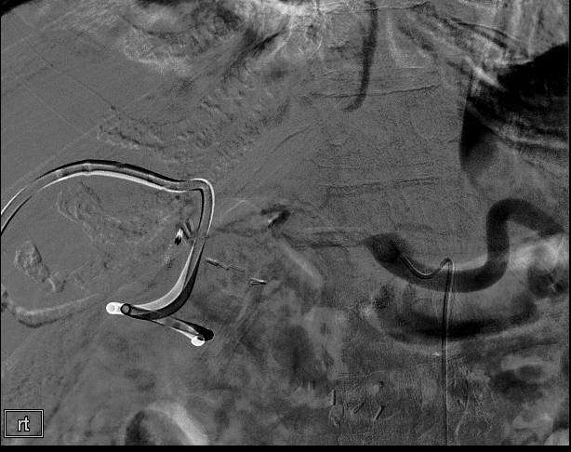
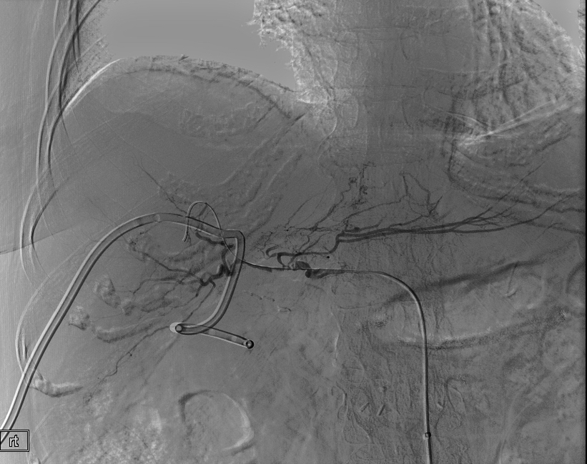
Post angioplasty

Slide 29
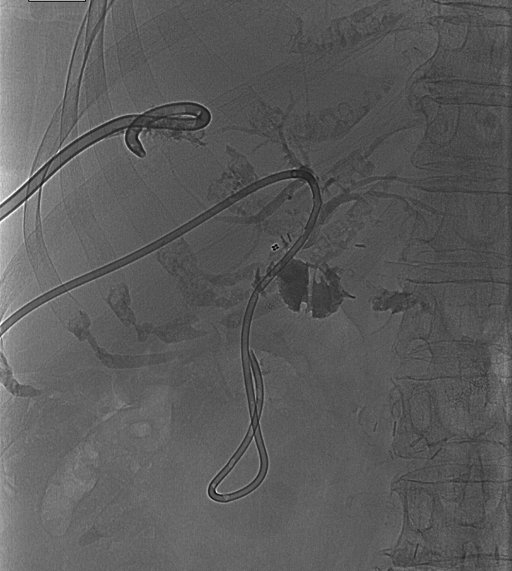
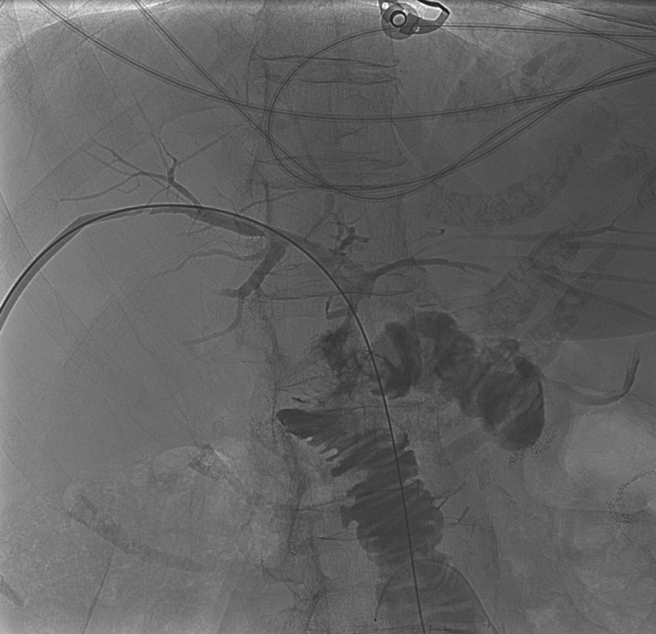
3 months later

Slide 30
Complications
Major complications include
Sepsis (2.5%)
Hemorrhage(2.5%)
Pleural transgression
Notes:
Use of appropriate preprocedure antibiotics, permitting bile to drain from the obstructed biliary tree prior to contrast injection, minimizing the volume of contrast injected, and minimizing manipulation of the biliary tree are techniques to decrease the risk of sepsis related to biliary drainage.

Slide 31
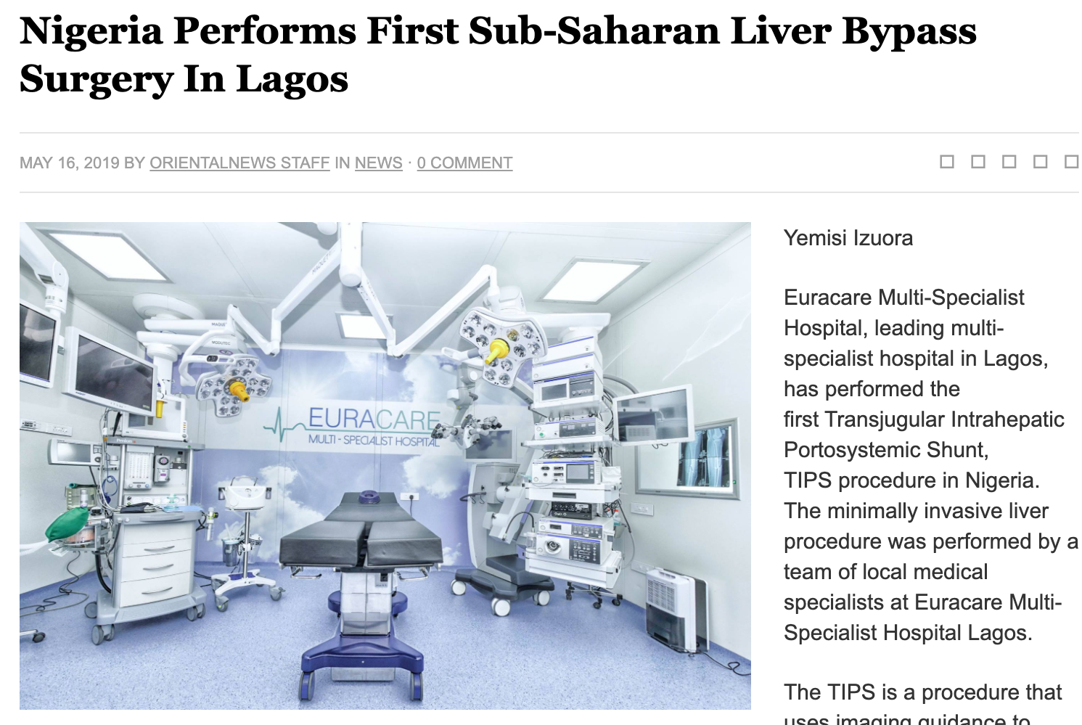
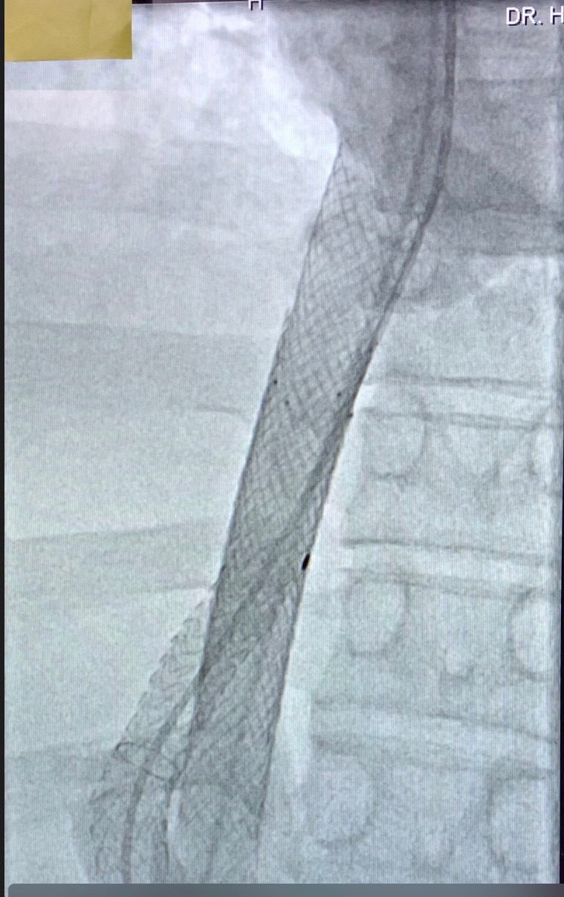
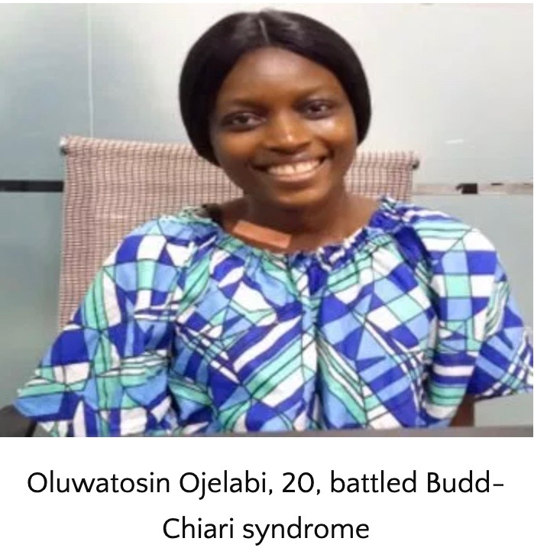
Other GI/Hepatobiliary services
Transjugular intrahepatic portosystemic shunts(TIPS) including portal vein recanalization.

Slide 32
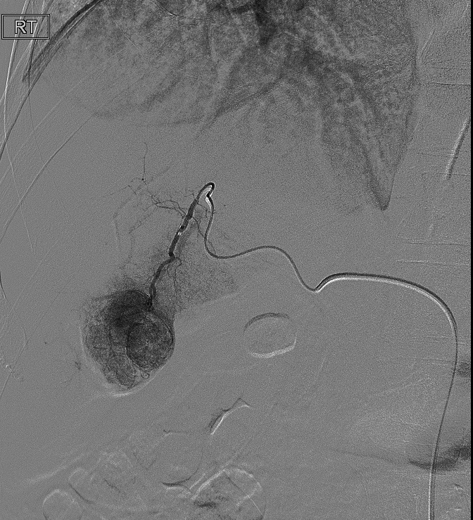
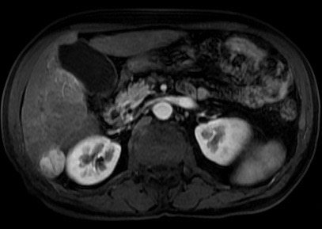
Other GI/Hepatobiliary services
Transarterial Chemoembolization for Hepatocellular carcinoma and Liver metastasis.
Microwave Ablation.

Slide 33
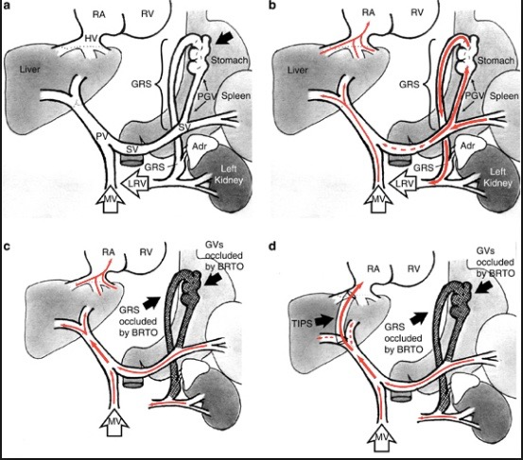
Other GI/Hepatobiliary services
Management of Portal Hypertension including
Transjugular Liver biopsy with portosystemic and hepatic venous pressure gradient assessment
Coil/Plug/Balloon assisted Retrograde transvenous obliteration(BRTO) of gastric varices.
Portal vein embolization.
Percutanoeus Cholecystostomy(Gallbladder drainage).

Slide 34
Thank you
Hammed Ninalowo MD, DABR IR/DR
Consultant Vascular/Interventional Radiologist and Interventional Oncology.
Founder and CEO, IRDOCNIGERIATM
Attending Physician, Geisinger Health System Pennsylvania, USA.
Email: hninalowo@irdocnigeria.org
Phone: 773-716-5062(Whatsapp), +2348055014160
Web: irdocnigeria.org

